Slide 1
Software needed
MongoDB Community Server
mongosh – command line client
Mongo Compass – GUI for database

Slide 2
MongoDB Basics

Slide 3
Relational vs Non-Relational Model

Slide 4



Relational Model: Data structure
Related data is stored in rows and columns in one table.
SQL (Structured Query Language)
A table uses columns to define the information being stored and rows for the actual data.

Slide 5
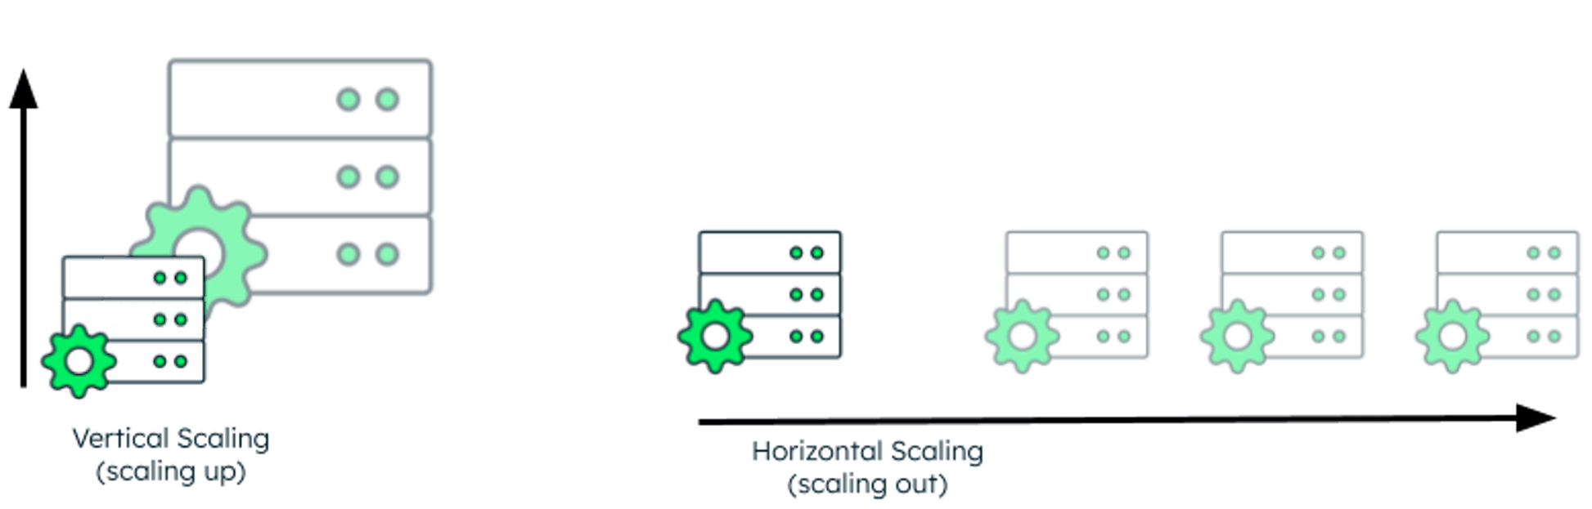
Relational Model: Scaling
Vertical
Add more CPUs
Add more RAM
Add more Disk space

Slide 6
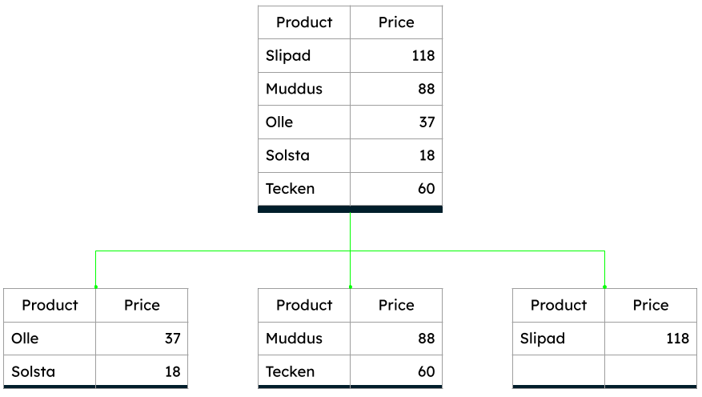
Relational Model: Sharding
A technique for Horizontal scaling
Distribute the Data across multiple smaller databases
Different patterns to split data (range based, date based, hash based, etc..)
Challenge: to keep the data evenly distributed
DB
DB1
DB2
DB3

Slide 7
Non-Relational Model

Slide 8
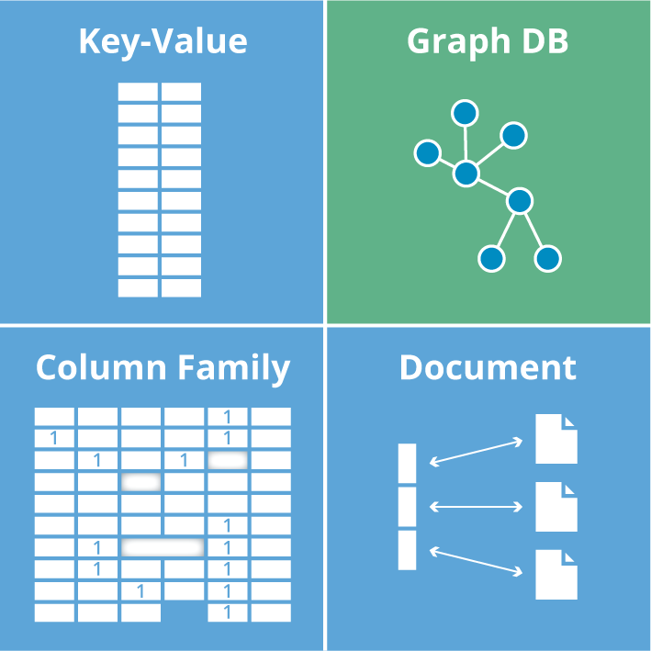
Non-Relational Model: Data structure
Polymorphic data structures
Flexible schemas
Easy to scale large workloads

Slide 9
Non-Relational Model: Scaling
Horizontal Scaling
Add more machines/instances to distribute the load

Slide 10
Non-Relational Model: Sharding
Concept is the same as in Relational model
Sharding is part of the architecture of NoSQL

Slide 11
MongoDB

Slide 12
MongoDB
Document based
JSON based documents (BSON)
Flexible document structure
Horizontal scaling by design

Slide 13
Document
{
"_id": ObjectId("607f1f77bcf86cd799439011"),
"name": "Ivan Petrov",
"age": 32,
"email": "ivan.petrov@example.com",
"address": {
"street": "Tsar Boris III N61",
"city": "Sofia"
},
"favouriteSports" : ["Cycling", "Running"]
}
JSON-based; Stored as BSON (binary json)
It is similar to Row (Record) in SQL
Consists of:
Fields (Attributes)
Sub-documents (Objects)
Arrays

Slide 14
Collection
{
"_id": ObjectId("607f1f77bcf86cd799439011"),
"name": "Ivan Petrov",
"age": 32,
"email": "ivan.petrov@example.com",
"address": {
"street": "Tsar Boris III N61",
"city": "Sofia"
},
"favouriteSports" : ["Cycling", "Running"]
}
…
{
"_id": ObjectId(“707f1f78cdf86cd799439011"),
"name": “Dimitar Ivanov",
"age": 25,
"email": “dimitar.ivanov@example.com",
"address": {
"street": “Pozitano 20",
"city": “Plovdiv"
},
"favouriteSports" : [“Swimming", “Treking"]
}
A group of documents
Similar to SQL table

Slide 15
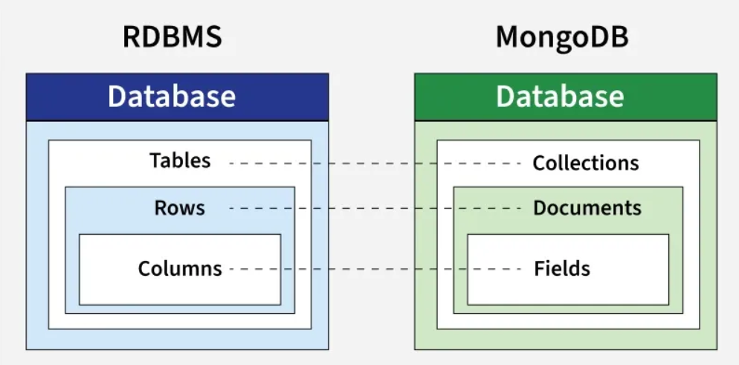
Database
A container for collections

Slide 16
CRUD

Slide 17
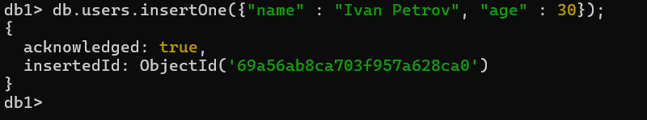
Create (insertOne)
db.<collection>.insertOne(<document>, <options>);
document – document to be inserted in JSON format
options – Optional. Specifies options for the operation

Slide 18
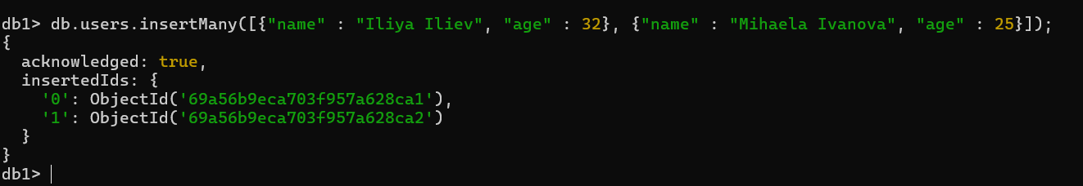
Create (insertMany)
db.<collection>.insertMany(<array_of_documents>, <options>);
array_of_documents – documents to be inserted in JSON format
options – Optional. Specifies options for the operation

Slide 19
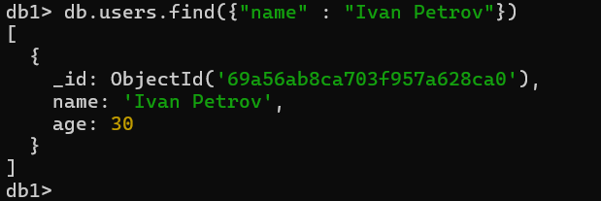
Read (find)
db.<collection>.find(<filter>, <projection>, <options>);
filter – Document used as search criteria. If missing, all documents from the particular collection are returned
projection – Optional. Document, which specifies which fields to be returned and which not.

Slide 20
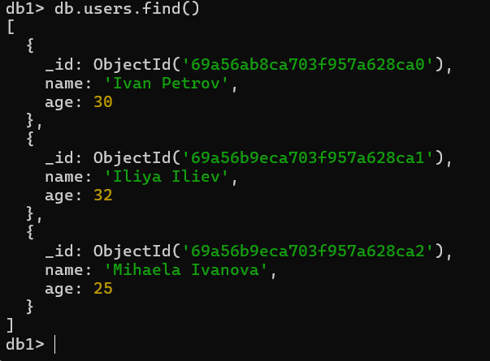
Read (find)

Slide 21
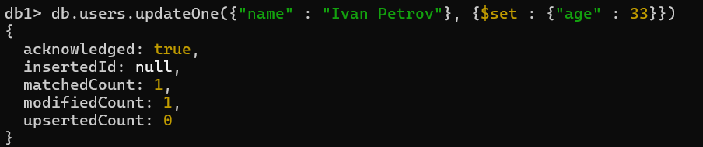
Update
db.<collection>.updateOne(<filter>, <update>, <options>);
filter – Document used as search criteria, in order to decide which document to update
update – Document, which specifies how to update the document
options – Document. Non-mandatory. Specifies options for the operation

Slide 22
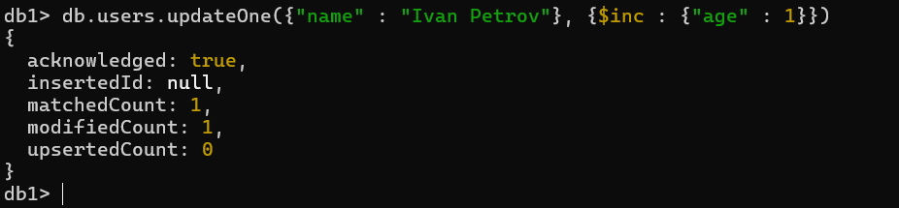
Update
Here, we use the operator $inc to increment age with 1.

Slide 23
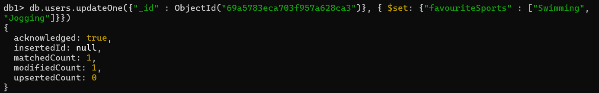
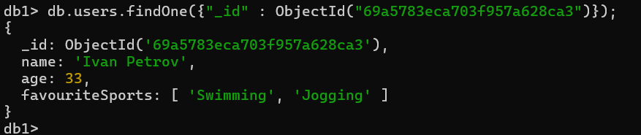
Update
Here, we use the operator $set to set the favouriteSports attribute with an Array value

Slide 24

Delete
db.<collection>.deleteOne(<filter>, <options>);
filter – Document used as search criteria, in order to decide which document to delete
options – Document. Non-mandatory. Specifies options for the operation

Slide 25

Delete
db.<collection>.deleteMany(<filter>, <options>);
filter – Document used as search criteria, in order to decide which documents to delete
options – Document. Non-mandatory. Specifies options for the operation
Here, we use the operator $lt (=less than) to delete all documents from users collection, which are younger than 35 yers old.

Slide 26
Other Important features
Indexes – Single field, Compound, Text, Geospatial, Unique, etc.
Aggregation Framework.

Slide 27
Scaling

Slide 28
Sharding Architecture
Application
Application
Driver
Config Servers
PRIMARY
•••
Mongos
Mongos
•••
SECONDARY
SECONDARY
Shard 1
Shard 2
Shard N
Primary
Primary
Primary
Secondary
Secondary
•••
Secondary
Secondary
Secondary
Secondary
Notes:
MongoDB sharding uses three components:
shards: Each shard contains a subset of the sharded data. Each shard must be deployed as a replica set.
mongos: The mongos acts as a query router, providing an interface between client applications and the sharded cluster.
config servers: Config servers store metadata and configuration settings for the cluster. As of MongoDB 3.4, config servers must be deployed as a replica set (CSRS).

Slide 29
Let’s try MongoDB!

